Slide 1
Dynamic Word Clouds
Martin Seyfert, Ivan Viola
Institute of Computer Graphics and Algorithms
TU Wien, Austria
Notes:
Good morning everyone, my name is Martin Seyfert and I’d like to present a set of new techniques to expand the famous Wordle algorithm for data that changes dynamically over time.

Slide 2
Motivation
Notes:
What we think of when we hear the term “word cloud” is a layout algorithm that was popularized by the website Wordle.net in 2009. The goal of Wordle was to provide a quick overview of word frequency in a text via font size in a way that is aesthetically pleasing, playful and easy to understand.

Slide 3
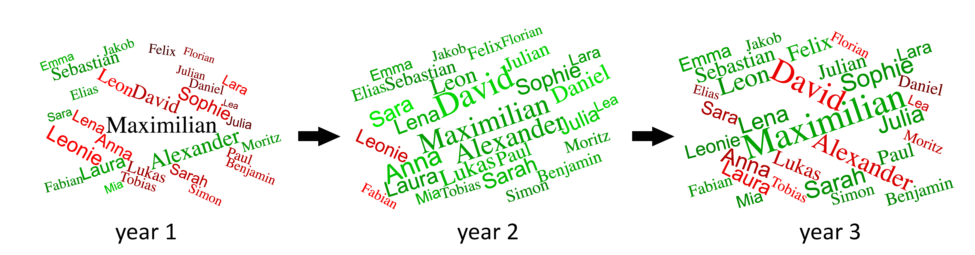
Motivation
Dynamic changes over time?
Challenges:
Compact Layout?
Readability?
Performance?
Notes:
We were interested in whether it would be feasible to expand the Wordle algorithm to display changes in word frequency over time

Slide 4
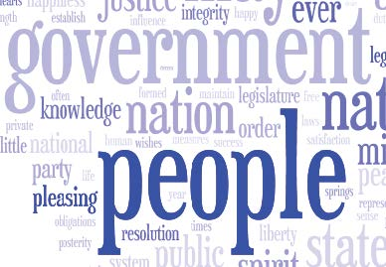
Related Work
Collision: Bitmap-based (per pixel) vs. Bounding-Box
Wordle: Bitmap-based
Wordbridge [Kim et al., 2011]: Bounding-Box

Slide 5
Related Work
On collision: Move outward along spiral path
Wordle, Jonathan Feinberg, 2009

Slide 6
Related Work
“Context Preserving Dynamic Word Cloud Visualization”, Weiwei Cui et al., 2010
Notes:
Used in conjunction with trend chart. Words are represented as simple bounding boxes and force directed models.

Slide 7
Related Work
“Morphable Word Clouds for Time-Varying Text Data Visualization”, Ming-Te Chi et al., 2015
Notes:
Generates complex illustration within interpolated shapes. Can require manual tweaking upon words blocking each other!

Slide 8
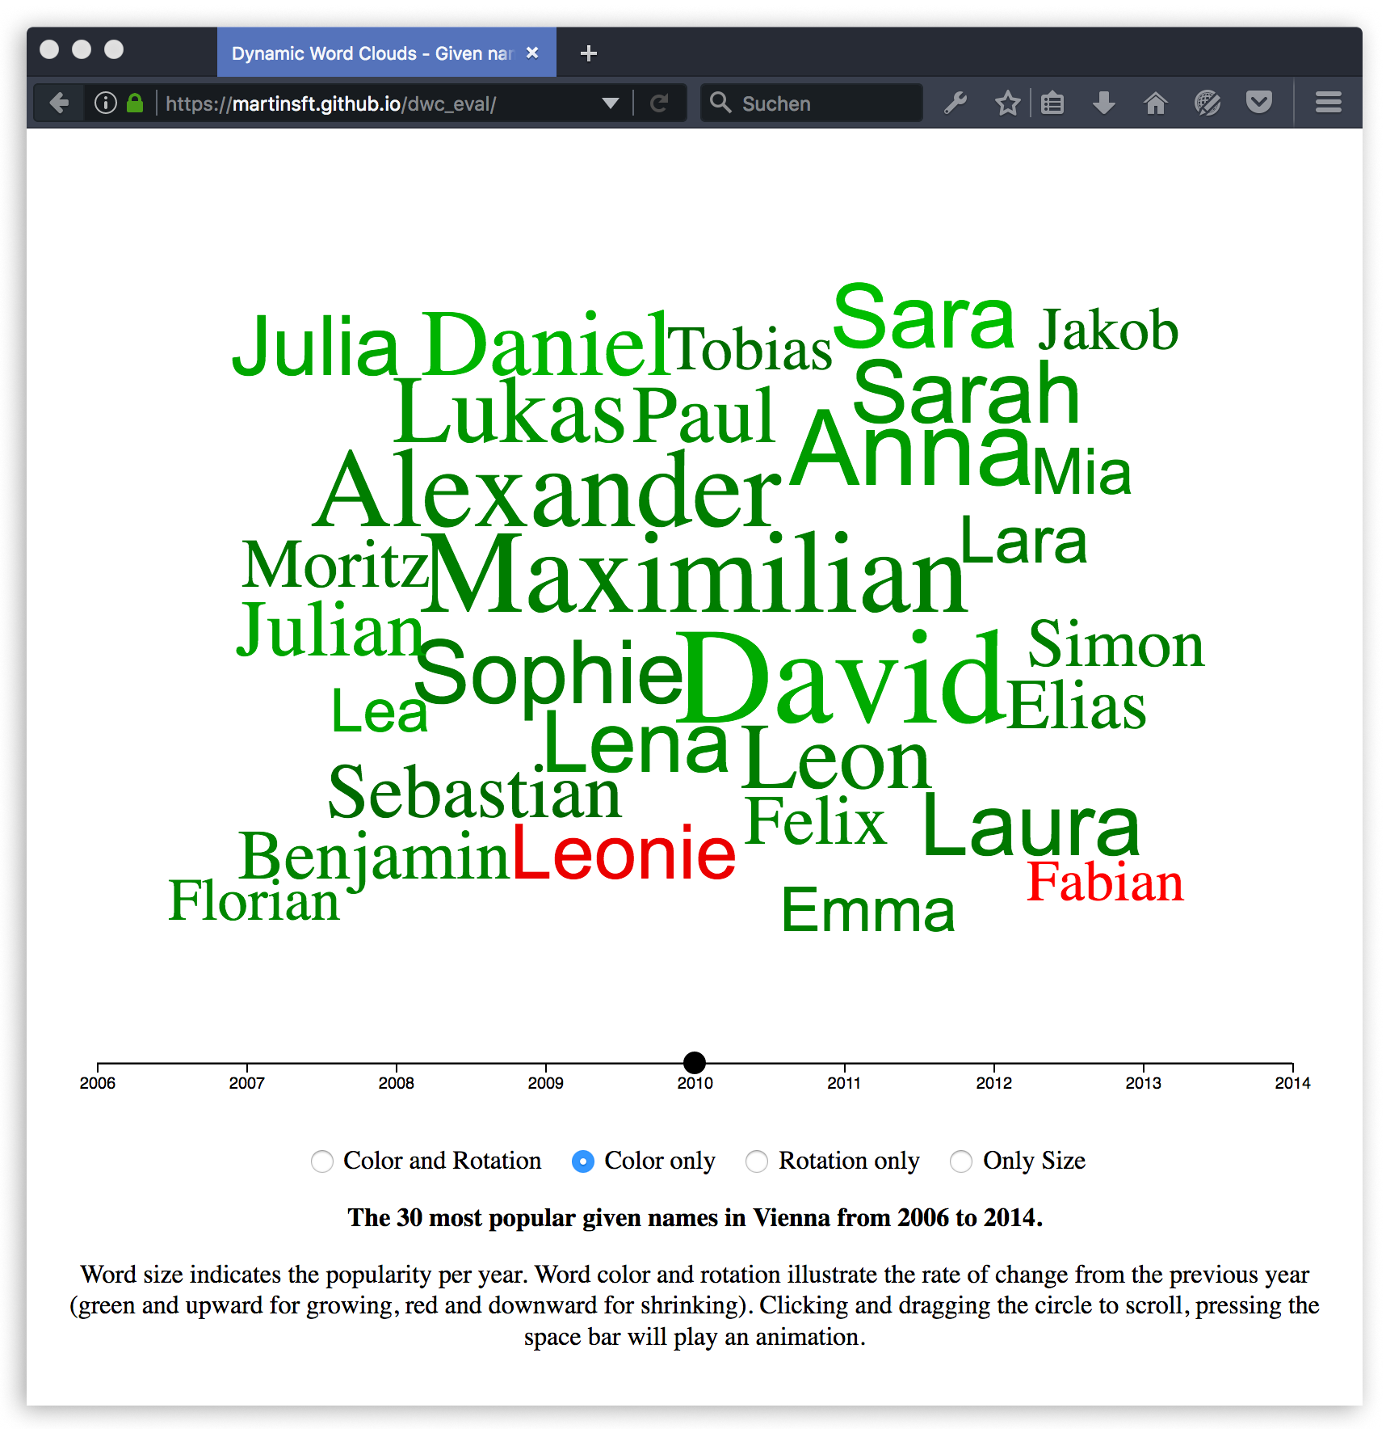
Goals and Requirements
Bitmap-based collisions
Smooth transitions (with minimal overlap)
Use typography for change information:
Color
Rotation
Font
Implementation using web technologies (HTML5, SVG, D3.js)

Slide 9
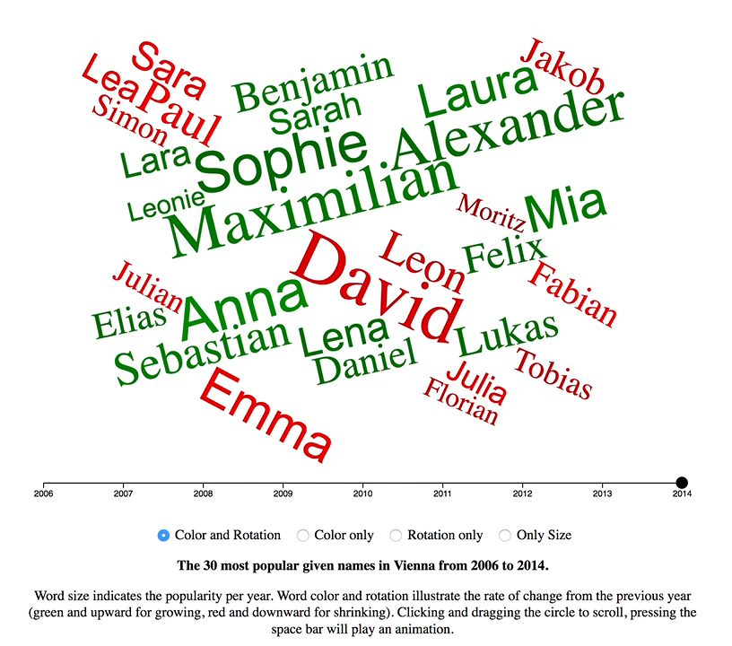
What does it look like?
Notes:
Because it’s a little hard to explain what the result would look like, I will not quickly demonstrate an implementation of our technique using a dataset of the 30 most popular given names in Vienna between 2006 and 2014. … Alright, so now I will go into a little more detail on how this was implemented.

Slide 10
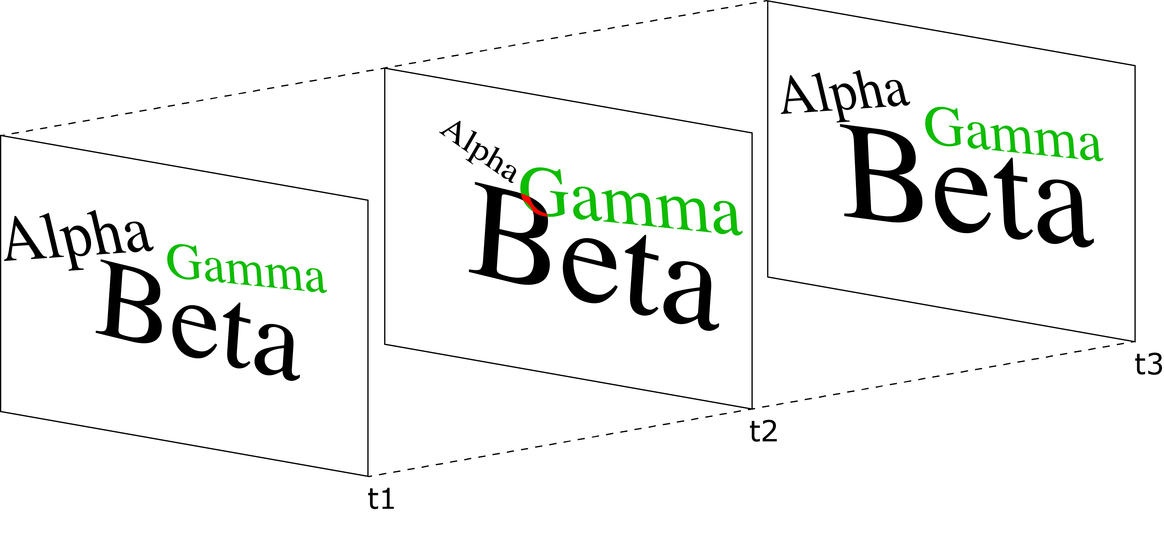
Collision
Collisions must be done in all keyframes simultaneously!
If collision is found in any keyframe, reject position and move further along outward rectangular spiral
Notes:
One of the key problems is correct collision. Because we need to avoid words moving too much in transition, we have to find positions that match in all keyframes at once.

Slide 11
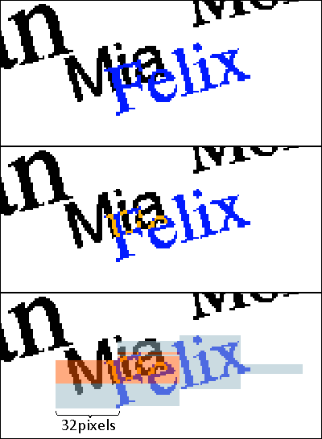
Bitmap Comparison
JavaScript is rather slow!
Collide Bitmap data:
Draw SVG text to HTML5 canvas
Store pixels as blocks of 32bit integers
Compare 32-pixel blocks via bitwise operation (logical AND)
32 comparisons at once!
Notes:
We need an efficient way to collide bitmap data. This is achieved by storing the bitmap pixel data in 32bit integers and performing bitwise operations on them.

Slide 12
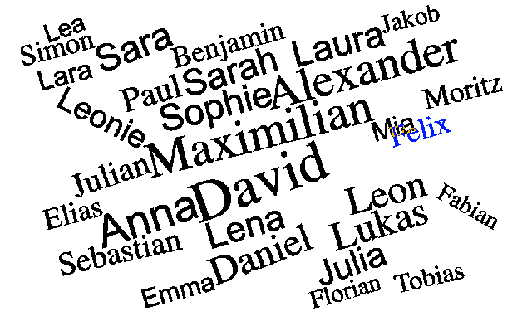
Collision
Basic algorithm:
Test for collision for next word against previous words

Slide 13
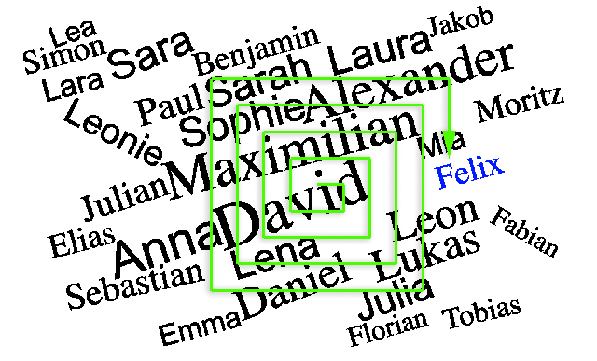
Collision
Basic algorithm:
Test for collision for next word against previous words
If collision is found, move along outward spiral

Slide 14
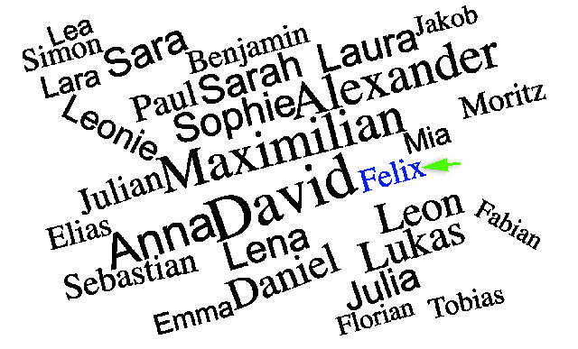
Collision
Basic algorithm:
Test for collision for next word against previous words
If collision is found, move along outward spiral
If no collision is found, try moving word towards center, continue with next word
Notes:
… But how do we choose the word order?

Slide 15
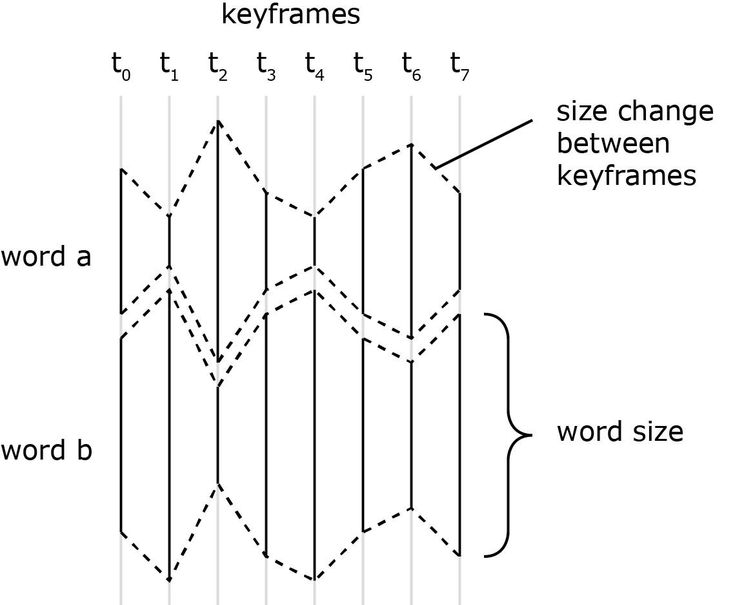
Word Placement Order
Idea: Choose next word based on how well its growth complements previous word sizes!

Slide 16
Word Placement Order
Idea: Choose next word based on how well its growth complements previous word sizes!
In practice: Sorting by average size is good enough

Slide 17
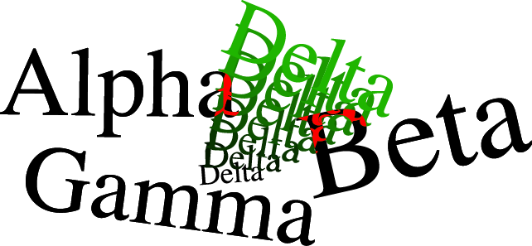
Frame Interpolation
Overlaps can occur during animation
Solution: Collision on interpolated frames (adds further computation time during generation)
Notes:
One minor problem that remains is words overlapping during transitions.

Slide 18
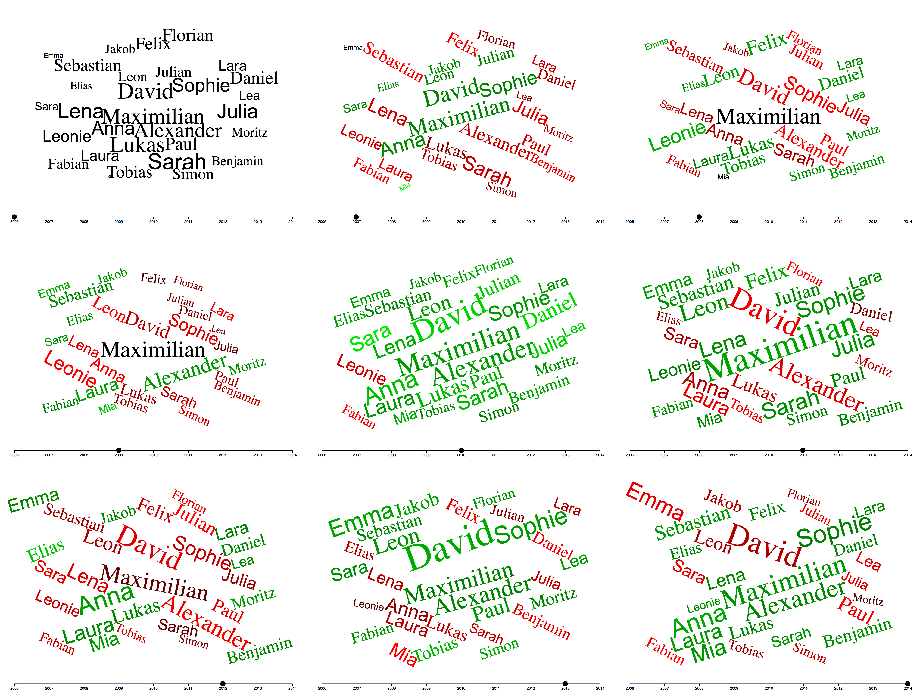
Results
30 most popular given names in Vienna 2006-2014

Slide 19
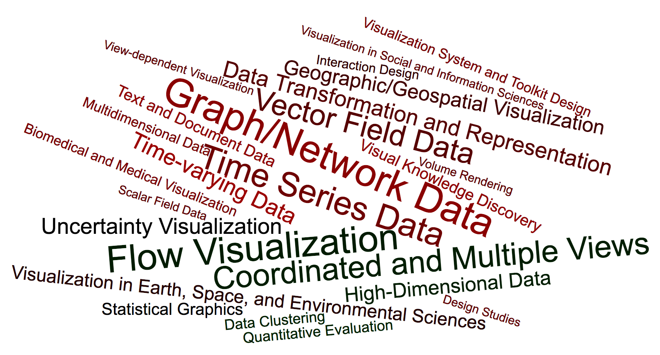
Results
Submitted vs accepted keywords, PacificVis 2016, weighted around a 0.5 ratio
Notes:
This is an example of a dataset with only two keyframes. The extreme word length limits the word cloud layout.

Slide 20
Evaluation
Short user study with 12 participants
Given names dataset, pre-generated layout
Slider, space bar starts animation
4 options (color only, rotation only, color and rotation, neither)
Roughly 5 minutes of interaction time
Afterwards, questionnaire about preferences, noticed trends, feedback

Slide 21
Evaluation: Results
Preferred visualization method:
Color only (50%)
Color and rotation (33%)
Rotation was considered overwhelming or confusing by many

Slide 22
Evaluation: Results
Trends noticed:
Words which remained larger over the whole time span (Maximilian, David)
Strong growth of individual words (Mia)
Overall growth in the year 2010
Short one- or two-year popularity spikes
Notes:
As typical for word clouds, exact measurements and comparisons were considered difficult but stronger overall trends were noticed.

Slide 23
Evaluation: Results
General feedback:
Most users found the visualization to be inviting and fun
Categorization through font type (Times/Arial for male/female) too subtle to notice
Rotation was considered confusing
Most users could imagine using the visualization for analyzing other tasks in the future

Slide 24
Evaluation: Expert Feedback
Ming-Te Chi, author of one of the two main reference papers (“Morphable Wordclouds”):
Too many changing attributes could lead to “change blindness”
Single hue of varying saturation could help tracing individual words

Slide 25
Future Work
More elaborate evaluation (more data sets, more in-depth user study)

Slide 26
Future Work
Performance optimization (10s+ generation times)
Notes:
Currently, the wordclouds would be pre-generated before presenting them to a wider audience. Bottleneck is collision detection. Optimizations possible through parallelization, more elaborate placement algorithms, utilizing the GPU for bitmap operations or through compromises using simpler collisions.

Slide 27
Future Work
Handling of streaming data (currently, all sizes must be known in advance)

Slide 28
Conclusion
A novel approach for Dynamic Word Clouds:
Using Bitmap-based collisions
Using typography instead of secondary visualization methods
Implemented entirely using web technologies
Future work:
More in-depth evaluation
Performance
Extension to streaming data

Slide 29
Thank you for your time!

